Slide 1

Bachelor Of Science
In
Computer Science & Engineering
Project Hospital Network Design & Implementation Using CPT
Submitted by
Mohammad Sheikh Sadi
Program: BSC in CSE Batch: 31st
ID: 118CSE0002
Submitted To
Dr. Zahidur Rahman
Head of the Department of CSE & ICT
Date of Submission:

Slide 2
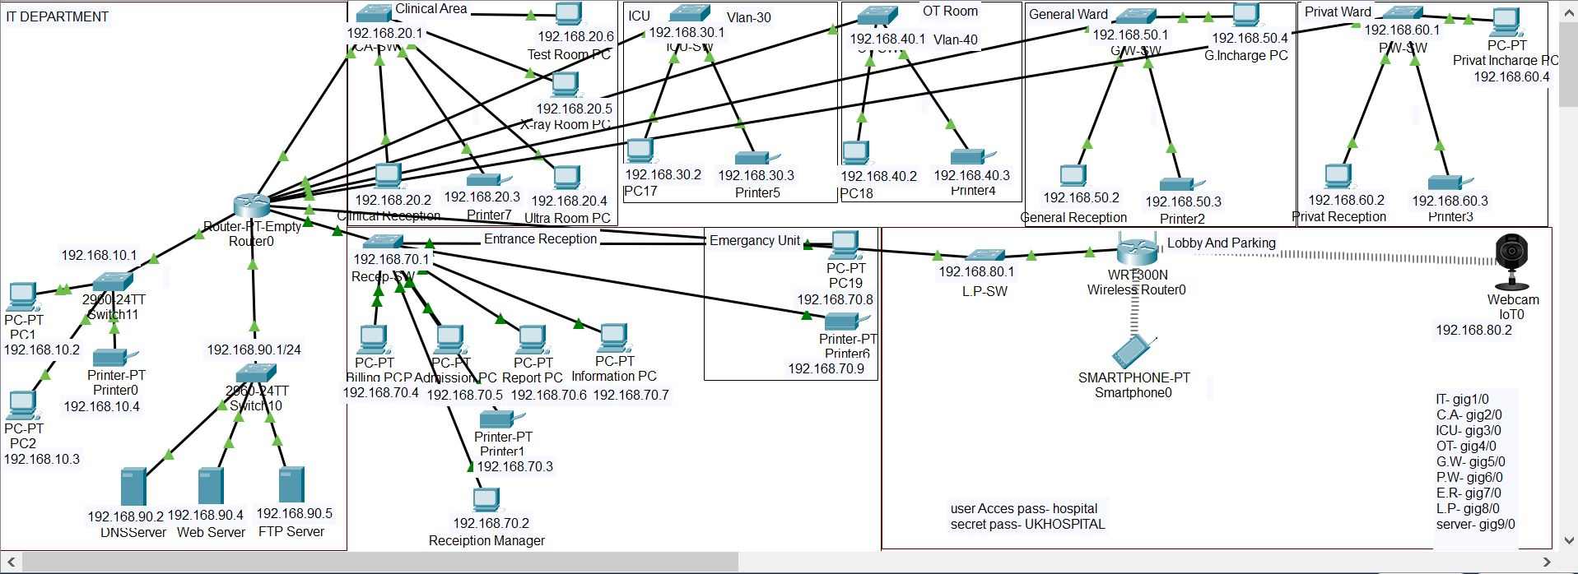
Hospital Network Design & Implementation Using CPT

Slide 3
Topic At A Glance
What is Internet
Objective of Networking in Health Care Organization
Summary of this networking
HOSPITAL SEGMENTS/Department
FEATURES AND SERVICES
DEFINITIONS
NETWORK REQUIREMENTS
NETWORK DIAGRAM
CONFIGURATION & IP Assign
SERVER SETUP
COST OF NETWORK

Slide 4

What is Internet
The internet, sometimes simply called the net. The Internet is an increasingly important part of everyday life for people around the world. A worldwide system of interconnected computer networks and electronic devices that communicate with each other using an established set of protocols is called internet.

Slide 5
Objective of Networking in Health Care Organization
Providing remote medical consultancy or to supervise the surgery/operation from remote location.
Uninterrupted high speed internet connectivity.
Provide better medical facilities to the patients.
Organized health records for future use.
Uninterrupted communication between different departments of the hospital.
Reducing the workload at nurse station, account department, reception desk.
Keeping the research work of the doctors and medical records of patients secure.

Slide 6
Summary of this networking
This networking implementation will dissect and analyze different part of the network of a hospital, uncovering substandard practices and problematic weakness that commonly result in a general decline in the quality of healthcare provided to patients, and adversely affecting hospital and healthcare facilities business operations. It can apply any hospital or health organization; I design a plan which helps in. Here I use star networking topology.

Slide 7
HOSPITAL SEGMENTS/Department
IT Department
Clinical Area
ICU
OT
General Ward
Privat Ward
Entrance Reception
Lobby and Parking

Slide 8
FEATURES AND SERVICES
DNS
Subnetting
HTTPS
FTP
WIFI

Slide 9
DEFINITIONS
DNS
The Domain Name System is a hierarchical and decentralized naming system for computers, services, or other resources connected to the Internet or a private network.
SUBNETTING
A subnetwork or subnet is a logical subdivision of an IP network. The practice of dividing a network into two or more networks is called subnetting.
HTTPS
Hypertext Transfer Protocol Secure is an extension of the Hypertext Transfer Protocol. It is used for secure communication over a computer network and is widely used on the Internet. Hypertext Transfer Protocol Secure is an extension of the Hypertext Transfer Protocol. It is used for secure communication over a computer network and is widely used on the Internet.
FTP
The File Transfer Protocol is a standard network protocol used for the transfer of computer files between a client and server on a computer network.
WIFI
Wi-Fi is the name of a wireless networking technology that uses radio waves to provide wireless high-speed Internet and network connections.

Slide 10
NETWORK REQUIREMENTS
In This Health care Network topology, we have desktop Computer, Printer, smart phone, webcam. There is a data flow between the devices within the system. We have divided our network into segments like for Emergency Unit, General wards, Privat Ward, OT Room, ICU Room, clinical area etc. Our network requirements include network devices like routers, switches, server.

Slide 11
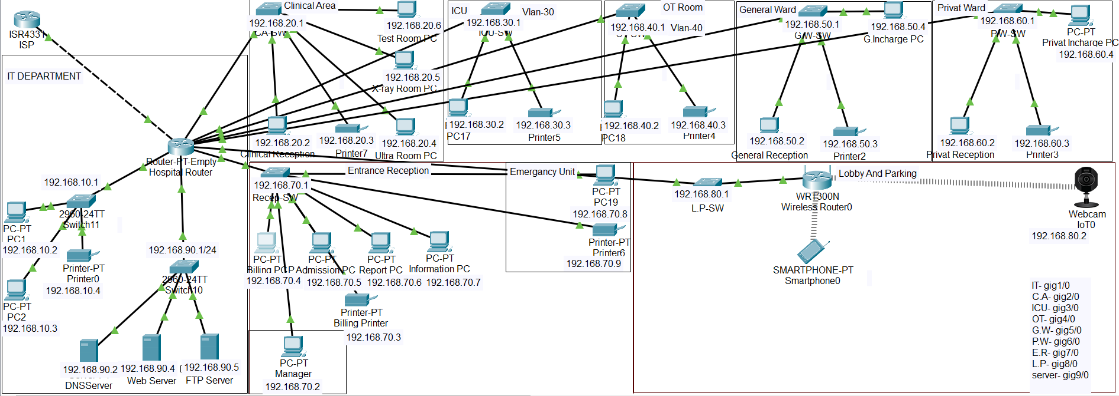
ISP
ISP: A network is of little of no use without internet. For the project as big as this consisting almost 50 end user accessing internet at the same time so we need a high speed internet speed internet from service provider. We cannot compromise on the internet speed.

Slide 12
Router
Router: in our network we have routers at one levels, one at the core level and the distribution layer. We need to handle the bandwidth of 100mbps for now. To handle this bandwidth we are choosing cisco The single-port Cisco Gigabit Ethernet Network Module (part number PT-ROUTER-NM-1CGE) provides Gigabit Ethernet copper connectivity for access routers. It can smoothly give throughput of 200mbps.

Slide 13
Switch
Switch: in a network, a switch is a port that broadcasts to every end device or Ethernet-based device connected to it. Here in our model we used Switch to connect switches of different sector. The reason behind doing is to increase the reliability. We can easily figure out the fault if any sector is not receiving internet connection. Here we use 2960 IOS15 model switch for each department.

Slide 14
Server
Server: server is a central system used for storing and managing data entire network. Here in our network we have installed three dedicate server i.e FTP server, DNS Server, HTTP /web server.

Slide 15
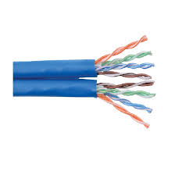
Cable
Cable: last but also the very important part is cabling the entire network. Without connecting one component of a network with other it is pretty much useless. Here in our model we had used unshielded twisted pair (UTP) cable to connect network router to switch, switch to server, switch to end devices. We chose UTP cable because of its interference cancelling capabilities. To be very particular we used cat-6 grade cables because of its maximum transmission speed of 1000mbps/100meters. There is not much cost difference between cat-5e and cat-6 grade cable. So it is a vice choice to choose cat-6 cable for our network.

Slide 16
End User Devices
User PC, Network Printer, wireless router are setup and connected by internet.

Slide 17
NETWORK DIAGRAM Use Star Topology

Slide 18
CONFIGURATION & IP Assign
The diagram is properly commented. We have divided the diagram into 8 segments as named above. Hospital Segments representing different
departments of hospital. Following are the running configuration of routers and switches related to different segments of hospital respectively:
Hospital Router 192.168.9.1 IT Department IP Address
192.168.10.1
Clinical Area IP Address
192.168.20.1
ICU Room IP Address
192.168.30.1
OT Room IP Address
192.168.40.1
General Ward IP Address
192.168.50.1
Privat Ward IP Address
192.168.60.1
Entrance IP Address
192.168.70.1
Lobby & Parking IP Address
192.168.80.1
Server IP Address
192.168.90.1

Slide 19
ISP Router Config for Hospital Router Port
Router>enable
Router#
Router#configure terminal
Enter configuration commands, one per line. End with CNTL/Z.
Router(config)#interface GigabitEthernet0/0/0
Router(config-if)#ip address 192.168.8.1 255.255.255.0
Router(config-if)#ip address 192.168.8.1 255.255.255.0
Router(config-if)#no shutdown
Router(config-if)#
%LINK-5-CHANGED: Interface GigabitEthernet0/0/0, changed state to up
%LINEPROTO-5-UPDOWN: Line protocol on Interface GigabitEthernet0/0/0, changed state to up

Slide 20
Hospital Router name Change
ukhospital by this command:
Router>enable
Router#
Router#configure terminal
Router#hostname ukhospital
ukhospital(config)#
ukhospital(config-if)#no shutdown

Slide 21
Hospital Router config for ISP Router Port
ukhospital>enable
ukhospital#configure terminal
ukhospital(config)#interface GigabitEthernet0/0
ukhospital(config-if)#ip address 192.168.9.1 255.255.255.0
ukhospital(config-if)#ip address 192.168.9.1 255.255.255.0
ukhospital(config-if)#no shutdown
ukhospital(config-if)#

Slide 22
Configure Other port for Segment Wise
Port Gig1/0
Click on Hospital Router, click on “CLI” then config by this command way:
ukhospital>enable
ukhospital#configure terminal
ukhospital(config)#interface GigabitEthernet1/0
ukhospital(config-if)#ip address 192.168.10.1 255.255.255.0
ukhospital(config-if)#ip address 192.168.10.1 255.255.255.0
ukhospital(config-if)#no shutdown
ukhospital(config-if)#
%LINK-5-CHANGED: Interface GigabitEthernet1/0, changed state to up

Slide 23
Routing
For transfer any data or packet we need routing all IP address by static routing by this command:
ukhospital>enable
ukhospital#configure terminal
ukhospital(config)#ip route 192.167.10.0 255.255.255.0 192.168.9.0
ukhospital(config)#ip route 192.167.20.0 255.255.255.0 192.168.9.0
ukhospital(config)#ip route 192.167.30.0 255.255.255.0 192.168.9.0
ukhospital(config)#ip route 192.167.40.0 255.255.255.0 192.168.9.0
ukhospital(config)#ip route 192.167.50.0 255.255.255.0 192.168.9.0
ukhospital(config)#ip route 192.167.60.0 255.255.255.0 192.168.9.0
ukhospital(config)#ip route 192.167.70.0 255.255.255.0 192.168.9.0
ukhospital(config)#ip route 192.167.80.0 255.255.255.0 192.168.9.0
ukhospital(config)#ip route 192.167.90.0 255.255.255.0 192.168.9.0
ukhospital(config-if)#no shutdown
ukhospital(config-if)#
and all IP address are routing with router to department wise IP Address.

Slide 24
SERVER SETUP
We need 3 server DNS,HTTP,FTP
DNS: Click Server, go to desktop assing ip address,subnet mask, default gatway, DNS address.
Then go services and click DNS, enable DNS service on and add name and IP address.
HTTP/Web Server: Click Server, go to desktop assing ip address,subnet mask, default gatway, DNS address.
Then go services and click HTTP, on HTTP, edit in index.html (if you customise website).
FTP Server: Click Server, go to desktop assing ip address,subnet mask, default gatway, DNS address.
Then go services and click FTP. Such as it a storage so it need security so creat a new username and password and give access as user. Here I access all permissio read,write,edit,rename,list. You can also see file that are storage by user.

Slide 25
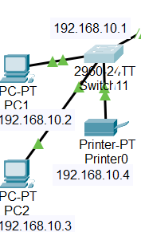
End user ip assigning and config

Slide 26
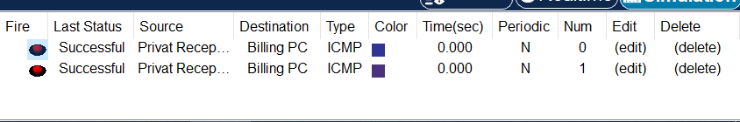
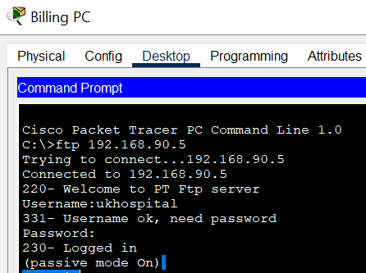
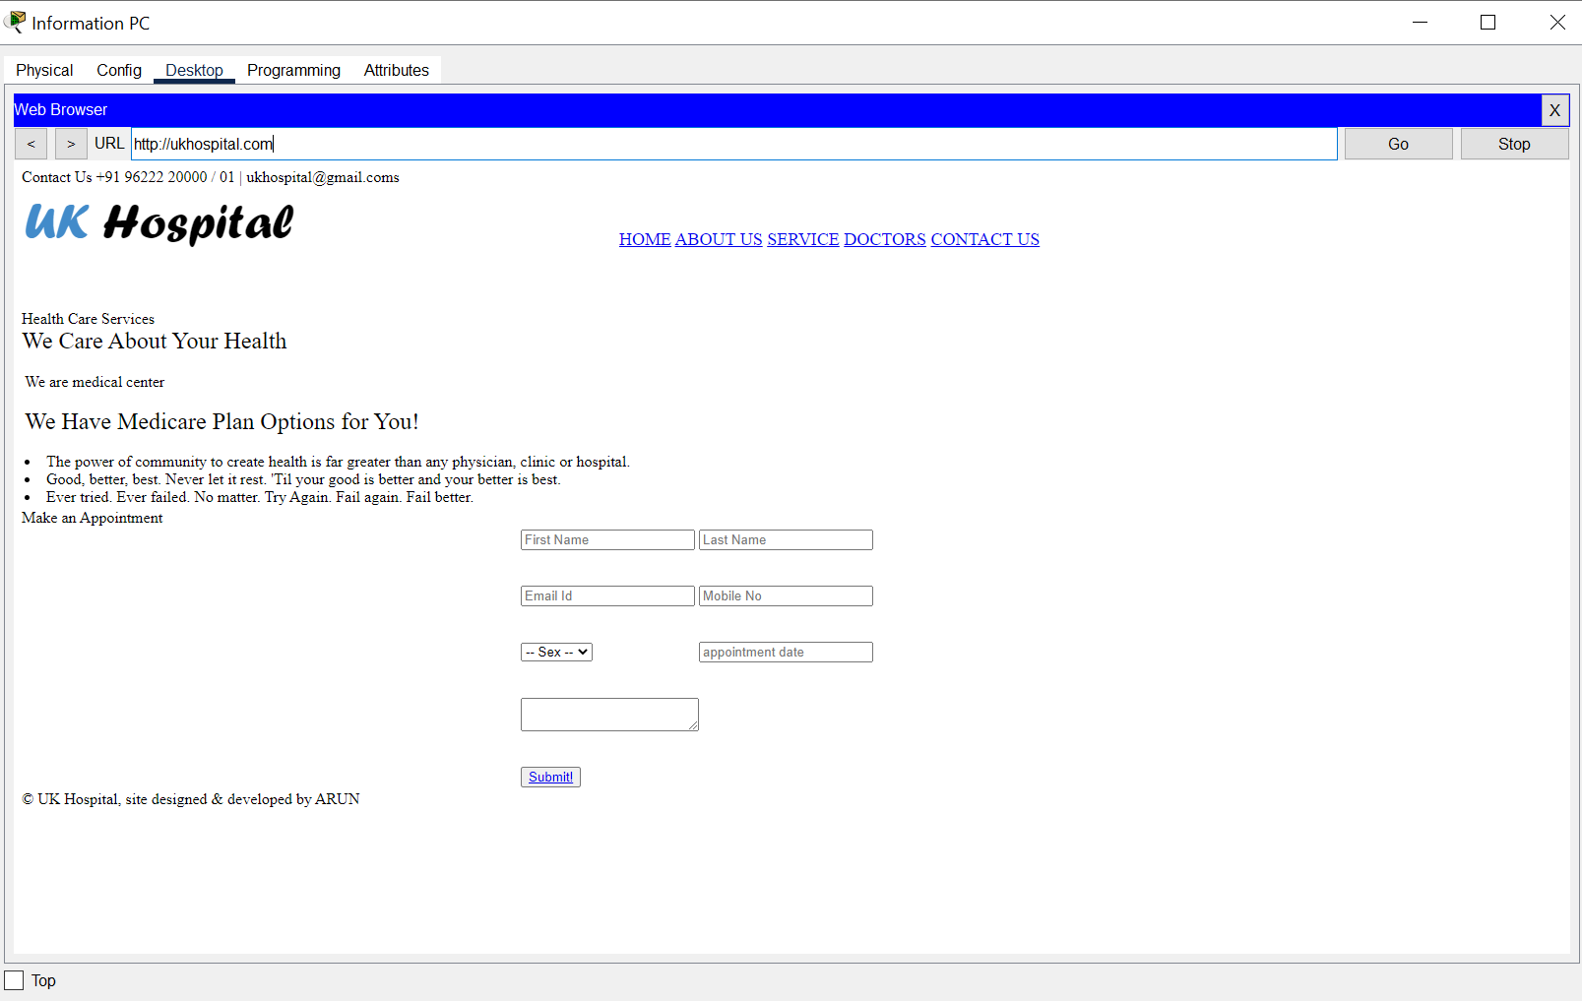
Result of Network implementation

Slide 27
COST OF NETWORK
Cisco Switch
$138 Each
$1242 Cost of 9 Switch
Cisco Router
$235 Each
$235 Cost of 1 Router
Cisco Server
$50 Each
$150 Cost of 3 Server
Computer Cost
$208 Each
$3744 Cost of 18 Computer
Printer Cost
$100 Each
$700 Cost of 7 Printer
Total Cost = $6071

Slide 28
CONCLUSION
With the growth of information technology in every sector and explosion of medical IOT devices, the design of a network of any hospital has become very essential factor. The hospitals need to have a reliable, secure and scalable network design in order to keep the patient’s information, doctor’s research work safe, convenient communication between various departments, etc. as well as keep it ready for any new IOT medical equipment that may be introduced in the future. The hierarchical model of networking best suits our needs along with providing additional features like easy maintenance, high security, simplified troubleshooting and effective performance.

Slide 29
Thanks To All

